Slide 1
Lab 1
Threads & Synchronization

Slide 2
Java Synchronization
Synchronized methods
Synchronized statements
https://docs.oracle.com/javase/tutorial/essential/concurrency/sync.html

Slide 3
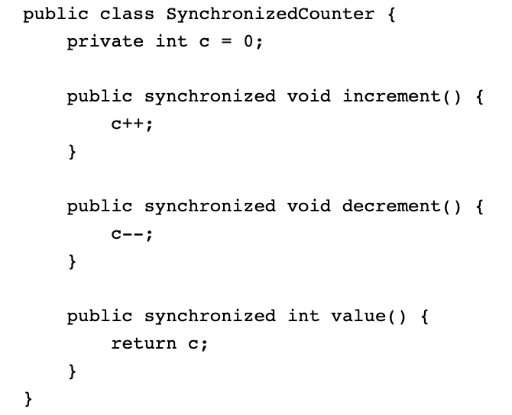
Java Synchronization
Synchronized methods
To make a method synchronized, simply add the synchronized keyword to its declaration

Slide 4
Java Synchronization
Synchronized methods
It is not possible for two invocations of synchronized methods on the same object to interleave. When one thread is executing a synchronized method for an object, all other threads that invoke synchronized methods for the same object block (suspend execution) until the first thread is done with the object.
When a synchronized method exits, it automatically establishes a happens-before relationship with any subsequent invocation of a synchronized method for the same object. This guarantees that changes to the state of the object are visible to all threads.

Slide 5
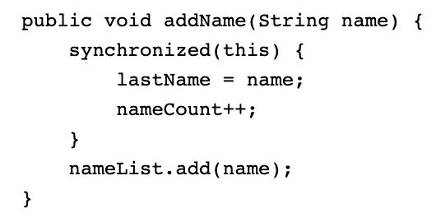
Java Synchronization
Synchronized statements
Unlike synchronized methods, synchronized statements must specify the object that provides the intrinsic lock
In this example, the addName method needs to synchronize changes to lastName and nameCount, but also needs to avoid synchronizing invocations of other objects' methods.

Slide 6
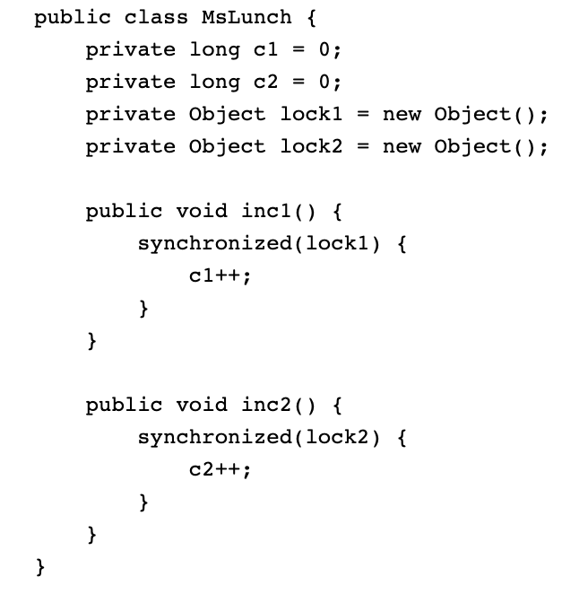
Java Synchronization
Synchronized statements
Synchronized statements are also useful for improving concurrency with fine-grained synchronization.

Slide 7
Lab Tasks
Task 1. Run the code as it is. The idea is that we have a Counter class and we want to increment it a number of times. Verify that the output matches your expectations.
Task 2. Delegate the work of increment the Counter to a separate thread. Start the thread and for it to finish its task. Verify once again that the output matches your expectations.
Task 3. Create two threads to do the job twice, i.e. we want to increment the Counter twice. What do you think of the output? Is this what you expected to get?
Task 4. Use an appropriate synchronization technique to ensure that you get the expected result.

